Slide 1

Literature Review VI-SLAM VINS-Mono
Ritvik Pandey
Intern H402743

Slide 2
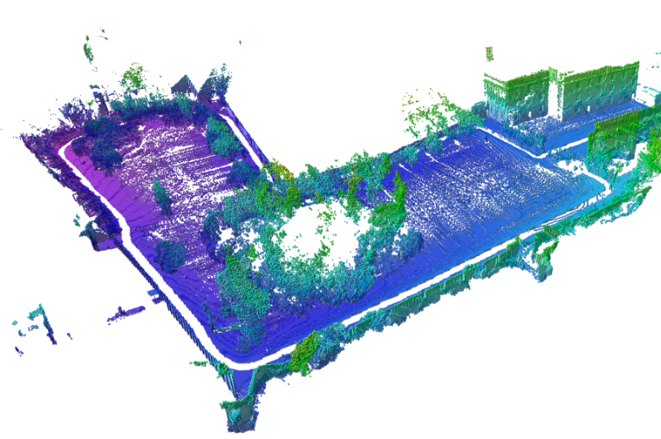
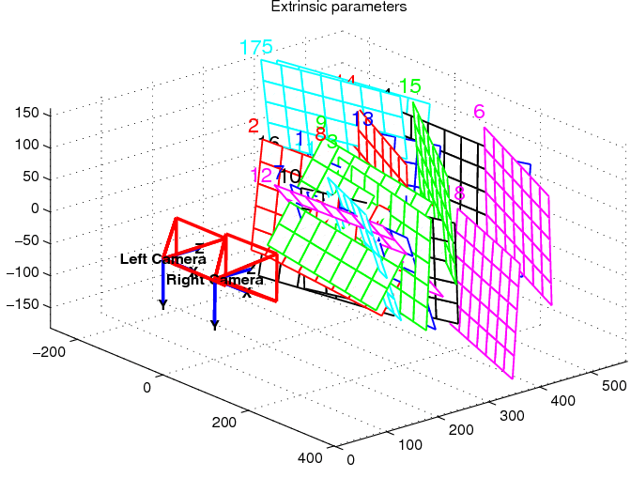
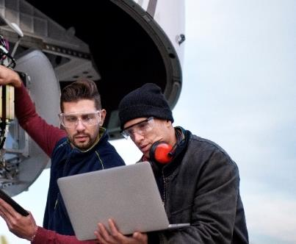
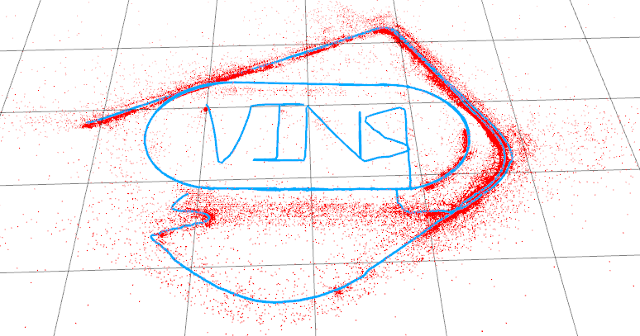
This presentation will cover
Overview of SLAM
Principle, Need
Setup, VIO
VIO Techniques
Standard modules
Working of these modules
Filtering based VIO
VINS-Mono
Addressing problems
Overview of steps
Working and formulations
Temporal caliberation
Why and how?.
Explaining VINS in application
To present the general picture of SLAM algorithms and their working in detail

Slide 3
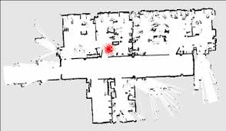
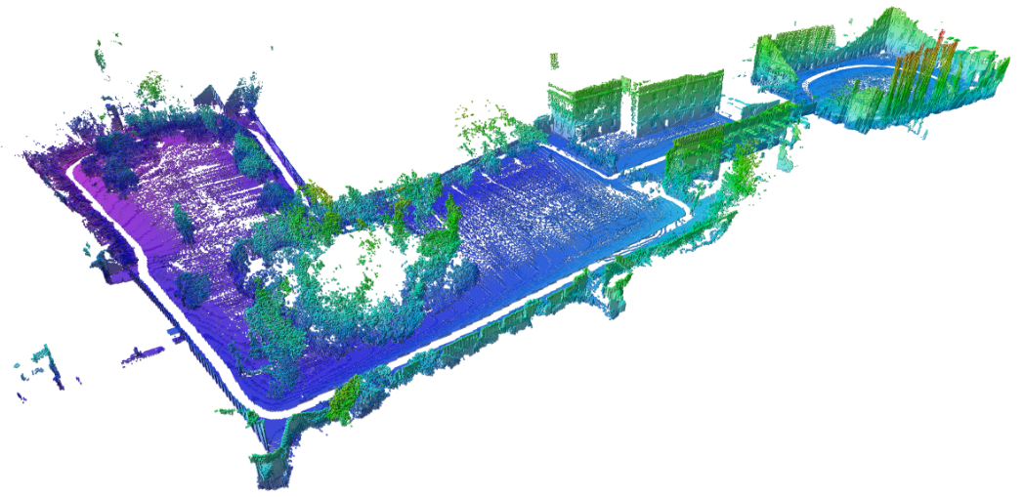
Overview: SLAM
Mapping
(What does the world look like?)
Requires access to observe and recognize landmarks
Camera, Lidar
Localization
(Where am I?)
Requires good odometry data. (where and how much I moved?)
IMU
The two essential components of SLAM

Slide 4
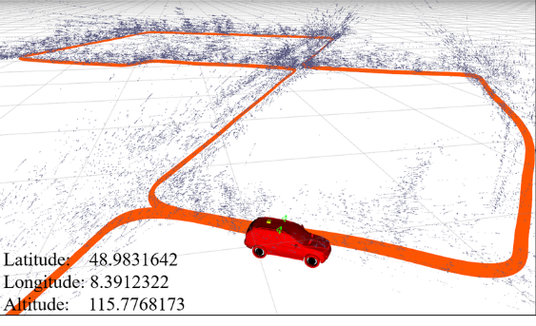
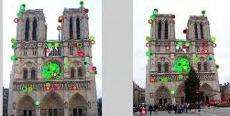
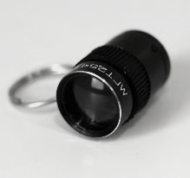
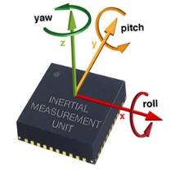
Overview: Key modules
OPTIONAL
Sensors and Pre-processing
Data from camera, LIDAR, IMU are fetched
Data is correspondingly pre-processed to be fed to successive modules
Feature detection and matching
Relation between current and previous frame
Keeps track of intermediate motion
Pose estimation and Global mapping
These intermediate motions are then used to locate drone in global frame
Loop closure and Bundle adjustment
Detecting previously visited area
Local and global data is adjusted again based on reconfigured values in bundle form
Any SLAM comprises of these modules

Slide 5
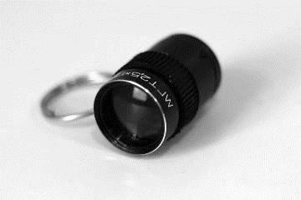

Overview: VI-SLAM
Visual data
Inertial data
Challenges
Monocular/Stereo camera
Has very less chances of error as drone is physically present there
Lacks Scale measurement
Low frequency
IMU measurements
Fast data
Has scale (metric)
Significant error in form of bias associated
How to integrate visual and inertial data
How to compensate time delay in receiving the data
How to deal with old data and large deviation
Minimize computation to make it real time
What if we loose track
How to detect and correct our estimates when visit a place again

Slide 6
VIO Techniques: Classification
Filtering based:
IMU to assist visual-only SLAM
Comprises of all the techniques which use some kind of filtering algorithm like
EKF (extended Kalman filter for non-linear problems)
Ellipsoidal Kalman filter
Dynamic Linear model
Faster and computationally cheap
Has larger error and memory consumption
Fail to recover from lost state
Optimization based:
Error from both IMU and visual data is jointly minimized
We calculate error from tracking of features of visual data and IMU data error to match with it, we then modify the estimates to minimize this joint error
Computationally intensive
Less error and memory requirement
May or may not recover lost state

Slide 7
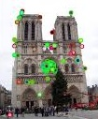
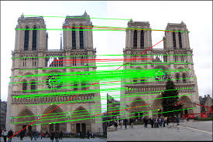
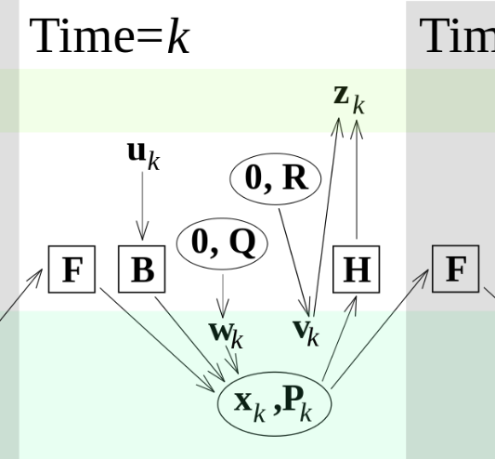
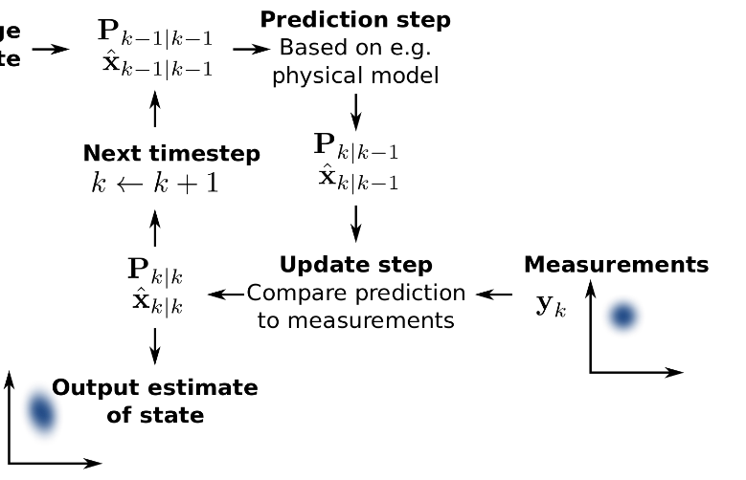
Filtering Based techniques: Overview
Feature Extraction and Tracking
Keypoints and Descriptor
Uses camera feed
- SIFT, SURF : Binacular-Vision SLAM
- Harris Detector: Mono-SLAM
- ORB: ORB-SLAM
Dynamic Observational Model
Control and State estimation using filtering pipeline
Uses IMU data
Extended Kalman Filter for non-linear problems
Two components of filtering based techniques

Slide 8
Feature Extraction and Tracking
Feature Extraction
Keypoints (corner, change in first/second order derivative at a point, local maxima/minima)
The value at which keypoint selected is its descriptor
Feature Tracking
Descriptors are matched with keypoints from other images and warping matrix is calculated.
SIFT, SURF : Binacular-Vision SLAM
Harris Detector: Mono-SLAM
ORB: ORB-SLAM
VINS uses BRIEF descriptor and KLT sparse optical tracker

Slide 9
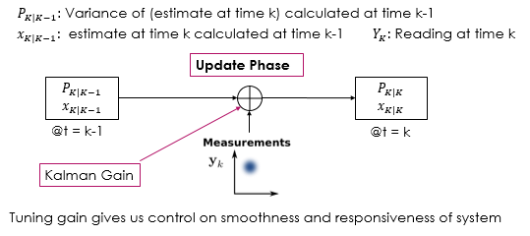
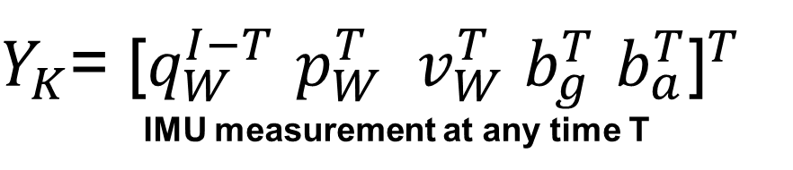
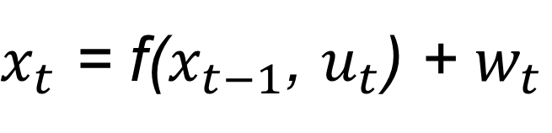
Filtering: Dynamic observational model
$x_{t}$ = f($x_{t−1}$, $u_{t}$) + $w_{t}$
Usage
Serves as both control and state estimation of the filtering pipeline
Need
In real world, data arrives with lag so an estimation is need of state of drone at each moment in time
$Y_{K}$= ${\text{[}q_{W}^{I−T} p_{W}^{T} v_{W}^{T} b_{g}^{T} b_{a}^{T}\text{]}}^{T}$
IMU measurement at any time T
Updating the new estimate and variance

Slide 10

Filtering: Dynamic observational model
$x_{t}$ = f($x_{t−1}$, $u_{t}$) + $w_{t}$
Usage
Serves as both control and state estimation of the filtering pipeline
Need
In real world, data arrives with lag so an estimation is need of state of drone at each moment in time
Prediction Phase
$Y_{K}$= ${\text{[}q_{W}^{I−T} p_{W}^{T} v_{W}^{T} b_{g}^{T} b_{a}^{T}\text{]}}^{T}$
IMU measurement at any time T
Prediction of state using previous state and control vector with noise

Slide 11
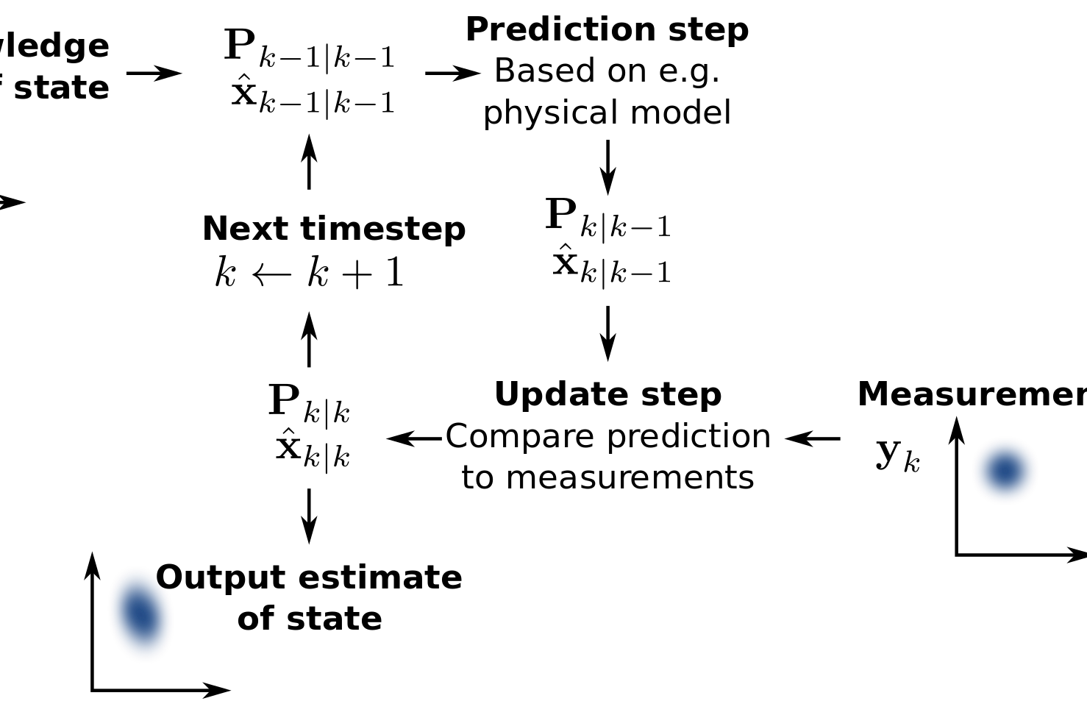
Filtering: Dynamic observational model
$x_{t}$ = f($x_{t−1}$, $u_{t}$) + $w_{t}$
Usage
Serves as both control and state estimation of the filtering pipeline
Need
In real world, data arrives with lag so an estimation is need of state of drone at each moment in time
$Y_{K}$= ${\text{[}q_{W}^{I−T} p_{W}^{T} v_{W}^{T} b_{g}^{T} b_{a}^{T}\text{]}}^{T}$
IMU measurement at any time T
Prediction of state using previous state and control vector with noise

Slide 12
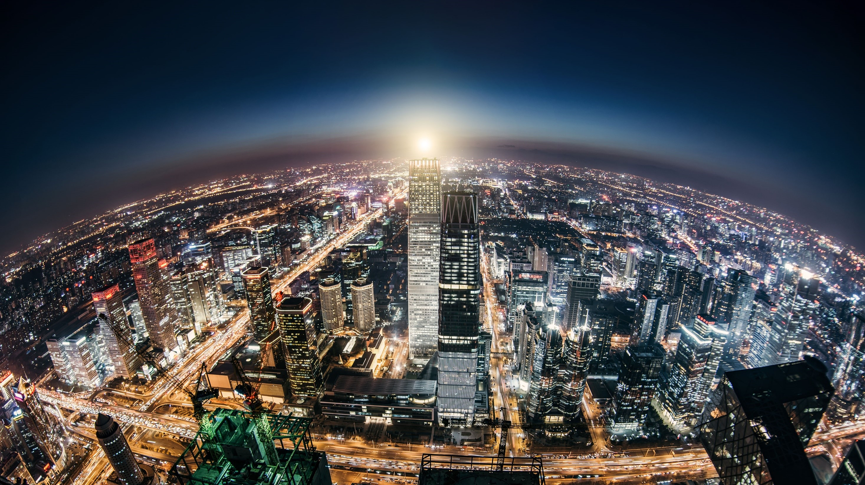
VINS-MONO Modules and working

Slide 13
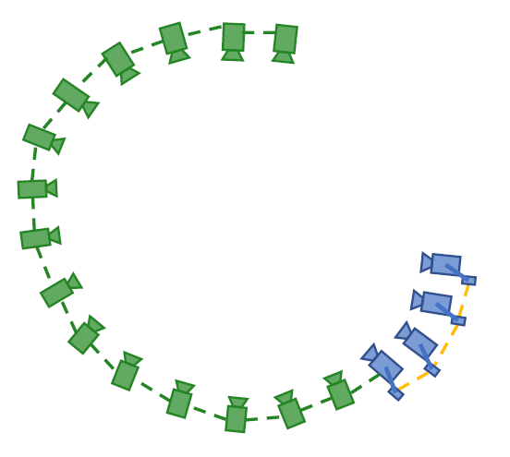
VINS-Mono: Introduction
State of the art tightly coupled non-linear optimization based SLAM
Local odometry
What is happening locally
Optimizing for local odometry errors
Relation with previous few frames and using intermediate IMU data
Global odometry
What is global picture
Taking previously accumulated errors in account
Relation with frames acquired long time back and visiting same point
SLIDING WINDOW
GLOBAL POSE GRAPH
As new frames arrive, we push older keyframes to pose graph

Slide 14
VINS-Mono: Introduction
State of the art tightly coupled non-linear optimization based SLAM
Pre-processing
Camera and IMU data is pre-processed and corrected for error before it is sent to any other module
Initialization
Getting initial estimation of position, velocity, orientation and scale
Core VIO algorithms
Successively updating state from previous state and new visual and Imu feeds.
Relocalization
On loop closure, the sliding window is optimized for newer position in space based on closure constraints
Global pose graph optimization
After relocalization, previous pose graph must be adjusted accordingly
Temporal Caliberation
Additionally, time delay b/w visual and IMU data must be estimated

Slide 15
VINS-Mono: Introduction
State of the art tightly coupled non-linear optimization based SLAM
Camera
Initialization
or
Core-VIO
Pre-Processing
IMU data
First Data
No initial estimate
Initialization
+ failure detection
Starting estimate
for Core-VIO
New Data
Previous estimates
Core-VIO algorithm
New estimates
Adjustment for drift accumulated
Previously visited place
(Loop detected)
Relocalization + Pose graph Optimization
Adjusted local and global odometry data

Slide 16
VINS-Mono: Pre-Processing
State of the art tightly coupled non-linear optimization based SLAM
Feature detection and Tracking
Key-point selection
Camera
Key-point Tracking
IMU data
IMU Pre-integration
IMU bias estimation
and parameterization
VISION PRE-PROCESSING
Feature Detection: BRIEF descriptor (rotational in-variant)
Feature Tracking: KLT sparse optical flow
Keypoint Outlier rejection: RANSAC + uniform special distance between keypoints
Keyframe selection: average parallax from previous keyframe more than threshold. Any image not a keyframe is thrown and only IMU data kept.

Slide 17
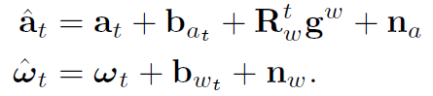
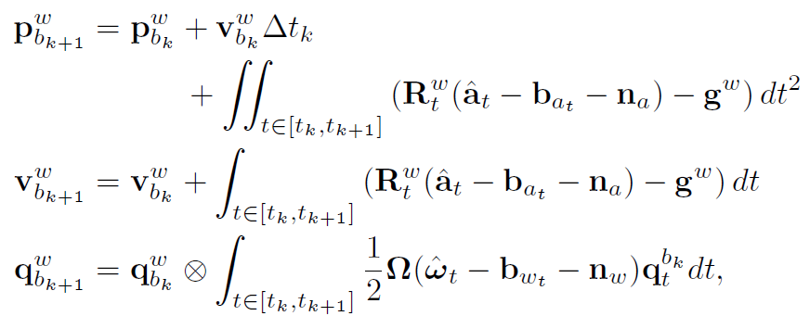
VINS-Mono: Pre-Processing
IMU Pre-Integration
IMU PRE-INTEGRATION
Why is it required
What happens in this process
Mathematical Formulation
Accelerometer and Gyroscopic measurements from IMU
Translation vector, Velocity vector and Rotation vector from body frame to world frame

Slide 18
VINS-Mono: Pre-Processing
IMU Pre-Integration
Why pre-integration?
NOTE: All these vectors use reference from previous measurement $b_{K}$ so if we find that an old estimation was slightly wrong, we need to re-propogate back to all those steps if same formulae are used.
Accelerometer and Gyroscopic measurements from IMU
Translation vector, Velocity vector and Rotation vector from body frame to world frame

Slide 19
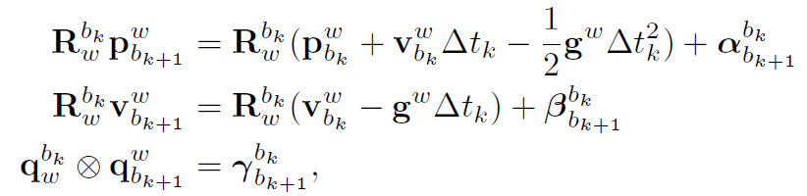
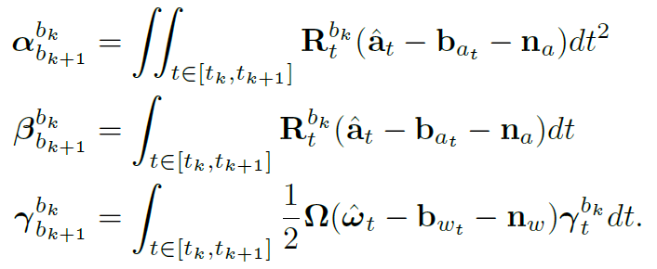
VINS-Mono: Pre-Processing
IMU Pre-Integration
New vector estimates which do not directly use previous measurements
Changing from world to body frame:
Here, α (alpha), β (beta), γ (gamma) only depend on bias and not on any previous state
So we need not to re-propogate whenever our bias estimate “b” changes

Slide 20
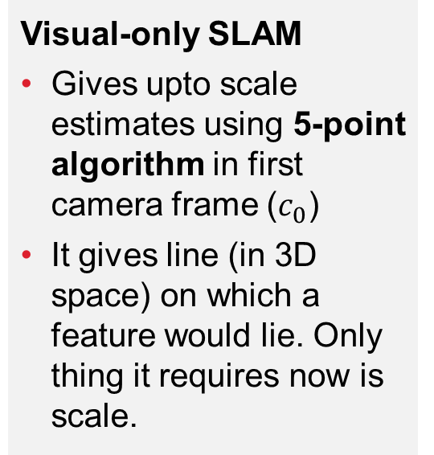
VINS-Mono: INITIALIZATION initial estimate of position, orientation, velocity, scale, bias
Structure from Motion (SfM)
Visual-Inertial Alignment
Final optimizing step for scale
Visual-only SLAM
Gives upto scale estimates using 5-point algorithm in first camera frame ($c_{0}$)
It gives line (in 3D space) on which a feature would lie. Only thing it requires now is scale.
Using visual data for bias correction
Optimizes rotational error between 2 consecutive frames to give gyroscopic bias estimation (gives gamma)
Alpha, beta are written in terms of scale
Optimizing for scale to minimize error in measurement
We have gamma and alpha, beta are written in terms of scale. Now the error between current and previous state (in terms of scale) is minimized to give us scale measurement
Finally, position, velocity are scaled and provided to core-VIO algorithm for successive update

Slide 21

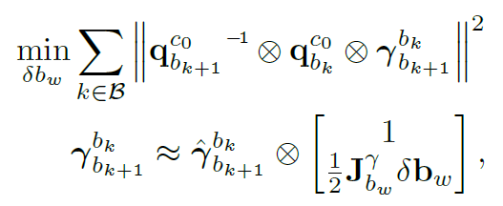
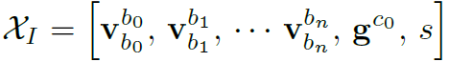
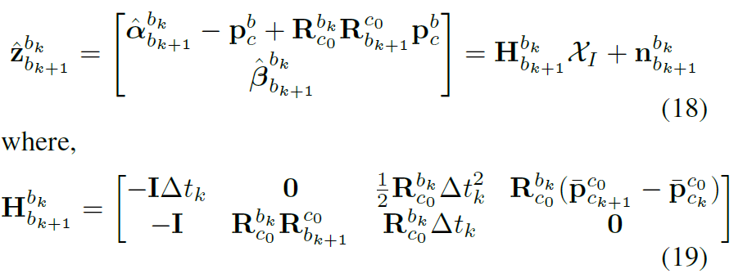
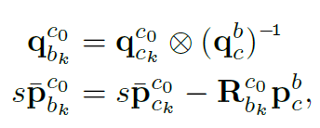
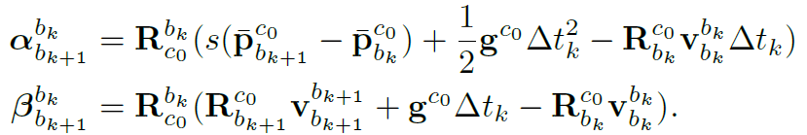
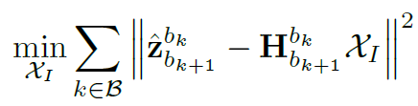
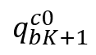
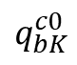
VINS-Mono: INITIALIZATION initial estimate of position, orientation, velocity, scale, bias
OPTIMIZATION 1
Gives gamma
Error optimization cost for bias estimation
From IMU pre-integration
$$q_{bK}^{c0}$$
$$q_{bK+1}^{c0}$$
Now we have good estimate of gamma and alpha, beta are written in terms of scale. The reading (z) at any given frame can be written as
From SfM
Equation governing translation and rotation in camera frame
Alpha/Beta in terms of scale and IMU readings
Gives Scale
OPTIMIZATION 2

Slide 22

VINS-Mono: Core VIO Algorithm
Using previous state and new visual and IMU data to update the state estimate
This module works only on Sliding Window part
Priori
Sliding Window
marginalized
If second latest image not a keyframe: its image data is thrown and only IMU kept. No frame marginalized
If second latest image is a keyframe: oldest frame in sliding window marginalized (converted to priori)
AIM: Keep latest and spatially separated keyframes in the window
Failure Detection and Bundle Adjustment

Slide 23
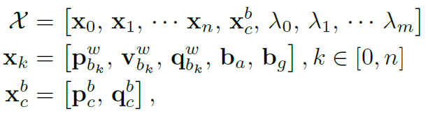
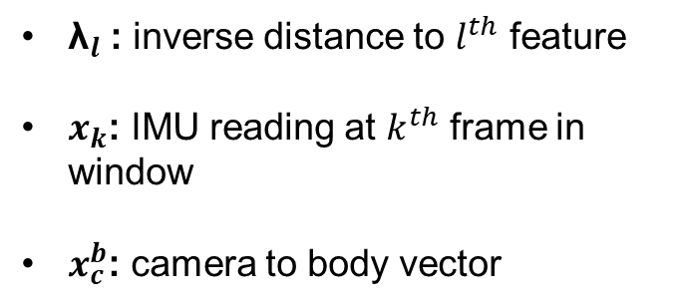
VINS-Mono: Core VIO Algorithm
Using previous state and new visual and IMU data to update the state estimate
This module works only on Sliding Window part
Priori
Sliding Window
State vector in sliding window can be represented as:
${\text{λ}}_{l}$: inverse distance to $l^{th}$ feature
$x_{k}$: IMU reading at $k^{th}$ frame in window
$x_{c}^{b}$: camera to body vector

Slide 24
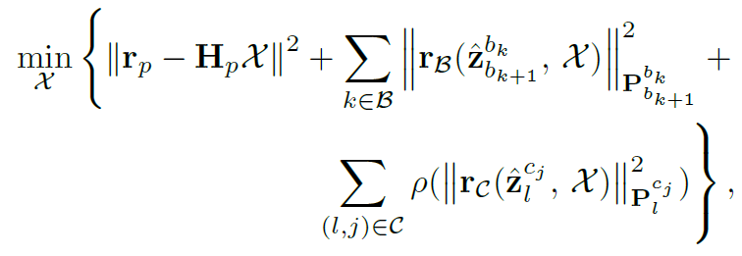
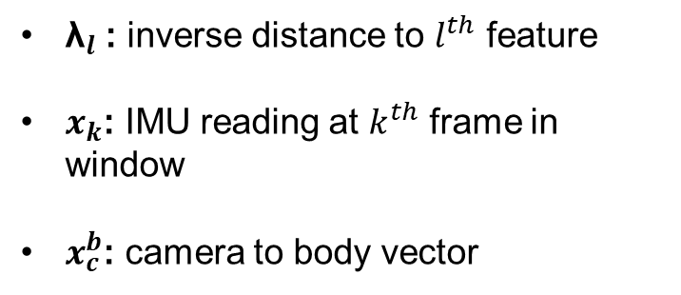
VINS-Mono: Core VIO Algorithm
Using previous state and new visual and IMU data to update the state estimate
Optimization function to be satisfied at each timestep
IMU residual error
Visual measurement residual error
Error due to prior information
State vector in sliding window can be represented as:
${\text{λ}}_{l}$: inverse distance to $l^{th}$ feature
$x_{k}$: IMU reading at $k^{th}$ frame in window
$x_{c}^{b}$: camera to body vector

Slide 25
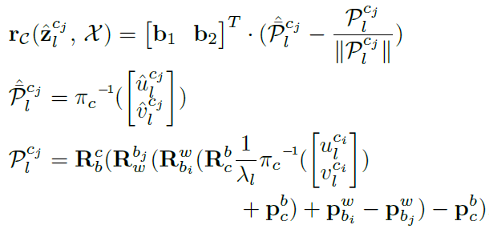
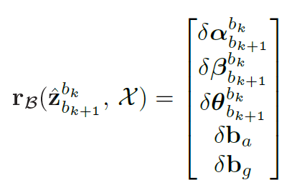
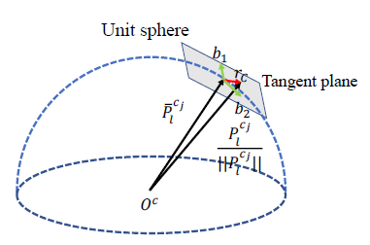
VINS-Mono: Core VIO Algorithm
Using previous state and new visual and IMU data to update the state estimate
IMU residual error
Visual Measurement residual error
Observed
Change in IMU states and bias estimates from previous frame to this frame by pre-integration step
Expected
What does it all mean?
It is just the scaled camera reprojection error of a feature
Error = Scale*(expected reprojection – true)
P : unit vector along reprojection

Slide 26
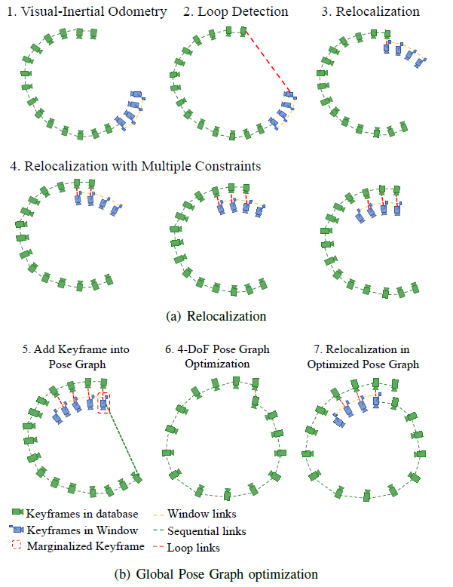
VINS-Mono: Relocalization v/s Pose Graph
Occurs at loop closure
Every effort is made to minimize error but still some drift occurs. When we visit a location again, our past knowledge and current position can help us correct for those drifts. Correcting those drifts in sliding window is Relocalization and thereby adjusting previous data according to it is Global pose graph optimization

Slide 27
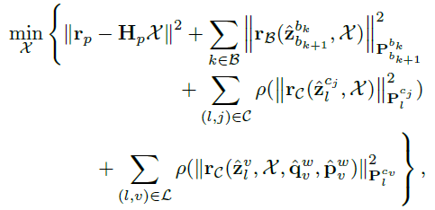
VINS-Mono: Relocalization
Relocalization has 2 steps:
Loop detection: DBoW2 (Database Bag of Words representation of image features indexed for fast retrieval)
Optimization
$l^{th}$ feature observed previously in $v^{th}$ frame
Hence apart from usual cost function for sliding window, we now have a term which constraints us with loop connections to give us new estimated state and thus minimizing the overall drift.

Slide 28
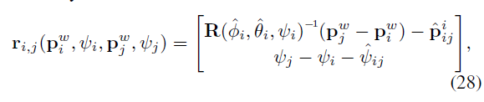
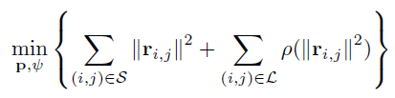
VINS-Mono: Global Pose Graph Optimizatio
As we have already relocalized the sliding window, the pose graph looks like image 5
4-Dof pose graph optimization:
Done according to sequential and loop closure edges residual error
Pose Graph
Sequential edges
Loop edges

Slide 29
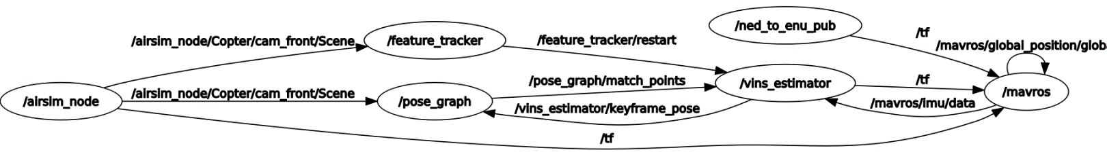
VINS-Mono: Working
Every /Scene data goes to /feature_tracker (pre-processing) and /pose_graph (detect loop closure)
If any matched points from previous poses, /pose_graph gives it to /vins_estimator (VIO-core) to optimize for it
All marginalized keyframes are saved in /pose_graph
Currently, we have set VINS to receive IMU data from mavros (can be made to take from airsim too)
Feature tracker tells /vins_estimator to restart if it looses track by a separate channel /feature_tracker/restart

Slide 30
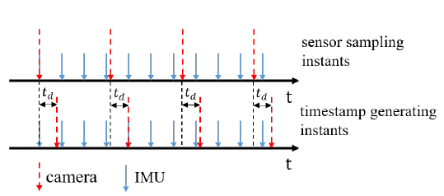
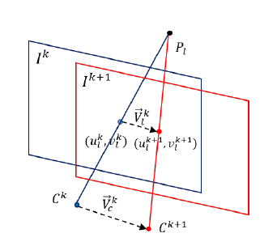
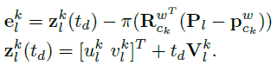
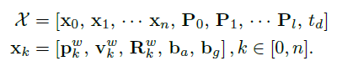



VINS-Mono: Temporal Caliberation
IMU and camera measurement don’t arrive at the same time, hence an estimate of time delay ($t_{d}$) is required
Expected location of feature considering time delay
New state function
Using same optimization cost function as before but with a newer state function

